Slide 1
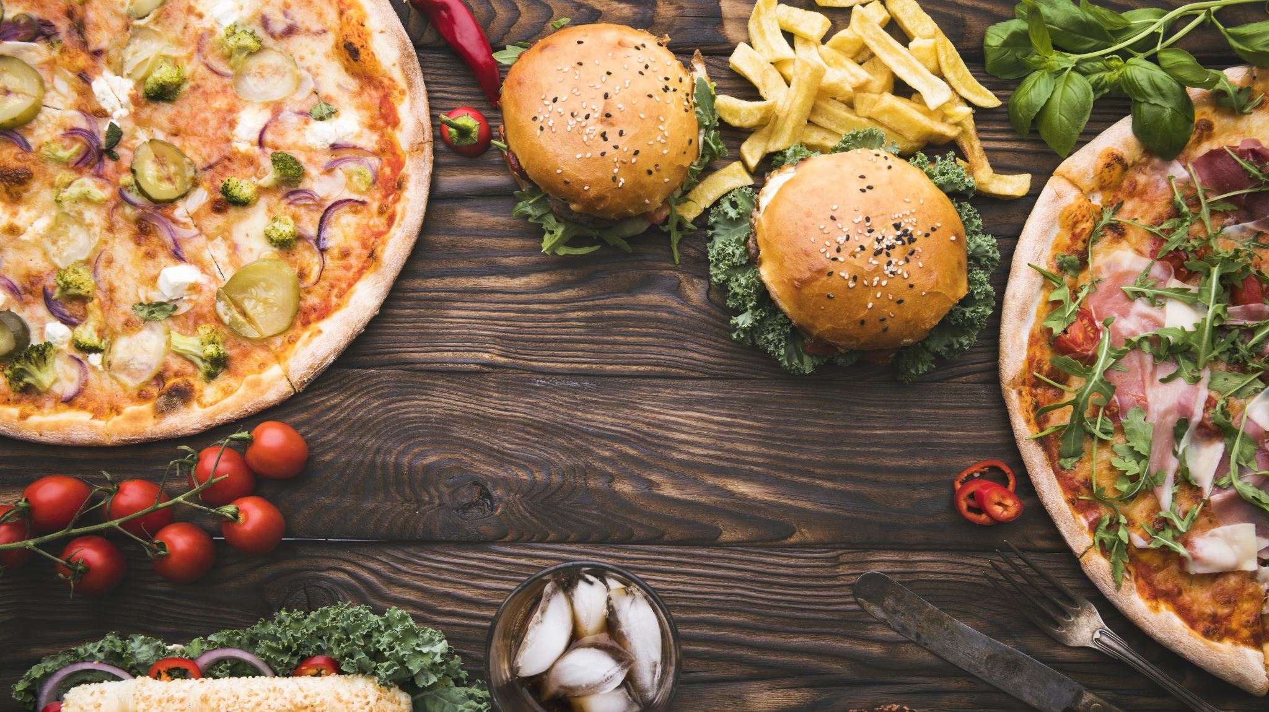
Project 1: OLAP Restaurant Services Database

Slide 2




Project 1 At a Glance:
NY Open Restaurant Applications (4.4MB) (14.5K Rows)
NY Open Restaurant Inspections (14.5MB) (79.2K Rows)
Project Management:
NY Food & Safety Inspections (90.4MB) (209.7K Rows)
NY YellowPages Restaurant Listings (1MB) (3K Rows)
Documentation:
EXTRACT
TRANSFORM
LOAD
Remove Duplicates
Deal with NULLs
Unify Column Naming Schemes
Create Keys
Discard Unneeded Columns
Create New Columns
Levenshtein Distance
Other
YellowPages.csv
(Scraped)
E.D.A. &
Viz.
Data
Modeling
Load into
PostgreSQL
Data.gov CSVs
(Open Data)

Slide 3
Questions and Challenges
What is the goal? Who are the Data Consumers?
Answering these questions will decide which Tables are going to be the source of our primary information and which Tables will be joined with supplementary information. This will also give us a direction on what Data should be kept, what new features we should introduce, and what Data may be discarded.
Scenario A: We are working with YellowPages to add new features to their mobile app, which lets users see if a restaurant is approved for the NY Open Restaurant initiative, and the restaurant’s Food & Safety Inspection results, if available.
The Data from the scraped YellowPages website is our primary data. We match the Inspection and Open Restaurant Tables with the Restaurants in the YellowPages table, and discard information for restaurants that are not in our list of Scraped information. However, our list of Scraped restaurants is limited to the top 100 results of restaurants in New York on YellowPages.
Scenario B: We are working for a market research firm, and the goal of our Analysts is to answer the following question: Do Restaurants that pass the NY Open Restaurant Policy and Food & Safety Inspections get higher review scores and better search result placements on YellowPages than those who do not?
In this scenario, we cannot discard the Inspection and Open Restaurant data, as that data is the bedrock of our analysis. Our analysts will match the YellowPages data to this data during their analysis.

Slide 4
Questions and Challenges
The scraped YellowPages Data is not exhaustive.
When searching for Restaurants in New York on YellowPages, we get about 3000 results. However, this does not mean there are only 3000 restaurants listed on YellowPages. When the same script is run multiple times, the resulting data starts to differ after the 2000 row mark. After running the script multiple times, I find that 8% of the resulting restaurants differ among the different datasets.
This could be because YellowPages’ search algorithm indexes search results based on relevance, traffic, ratings and a bunch of other factors. As we go down the list of results, the algorithm has fewer metrics to score restaurants by, and for the last few hundred results, it returns a random selection of restaurants that have the same score, from a potential pool of thousands of low-scoring restaurants.
Engineers working for YellowPages would have access to the complete Data, but there are ways we can make our data more representative of the actual list of restaurants in New York. By splitting our search by different tags, neighborhoods, or cuisines, we could get a more in-depth list of restaurants.
For example: We may only have about 200 Indian Restaurants in the top 3000 results on YellowPages, but by searching for Indian Restaurants in New York, we could get over 500 results of Indian Restaurants alone. By making multiple granular searches, creating dozens if not hundreds of smaller datasets, and by combining and removing duplicates from resulting datasets, we could get a larger list of restaurants that would make our final Database better prepped for analysis.
However, perfect is the enemy of good, and for this project, a smaller set of data may suffice.

Slide 5
Cleaning Steps:
Remove Duplicates
Remove {} Symbols from Global ID {FD87ABAA-860E-4762-845D-8F0403D0246B} becomes FD87ABAA-860E-4762-845D8F0403D0246B
Remove HTML Encoding from the columns &amp; becomes &
Capitalize Name, Business Name, Doing Business As, and Street Columns
However, the str.capitalize() function only capitalizes the first letter of the first word.
For example: ‘the highway bar’ becomes ‘The highway bar’
Instead, we use the str.title() function to capitalize every word.
Now, ‘the highway bar’ becomes ‘The Highway Bar’
But this leads to unintended consequences. Let’s dive deeper into those.

Slide 6
Dealing with Unintended Consequences:
Business Suffixes like ‘LLC’ become ‘Llc’
Ordinal numbers with suffixes like 1st or 2nd become 1St and 2Nd
Words like ‘don’t’, and ‘Rita’s’ become ‘Don’T’ and ‘Rita’S’
Additional Cleaning Steps:
Standardize Business Suffixes. Llc –> LLC, Inc/Incorporated -> Inc., Corp -> Corp.
Standardize Location Abbreviations: St/St. -> Street (but not when St. stands for Saint), Av/Ave/Ave./Av. -> Avenue, Ln/Ln. -> Lane, Blvd/Blvd. -> Boulevard
Change words like ‘Don’T’ and ‘Rita’S’ into ‘Don’t’ and ‘Rita’s
Extract Building numbers from Street Addresses into their own column
Change numbers into ordinal numbers First -> 1st , 1 Street -> 1st Street
Change invalid SLA License Number to a default (0000000)
Change NTA codes into words MN27 becomes Chinatown
Save as new CSVs

Slide 7
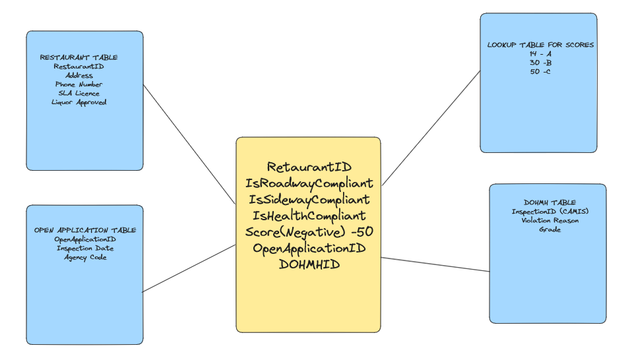
Sample OLAP Schema:
Each CSV has restaurants that are common between it and the other CSVs, as well as restaurants unique to itself that don’t occur in other CSVs. Hence, we need to create our own Restaurant Identification number
Dimension Tables
Dimension Tables
Fact Table
Dimension Tables
Dimension Tables

Slide 8
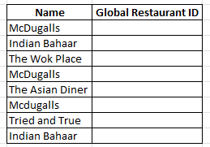
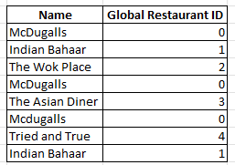


Enter: Fuzzy Wuzzy / Levenshtein Distance
The fuzz.ratio function compares two strings and gives us a score based on how similar they are. This is based on the Levenshtein Distace or Minimum Edit Distance algorithm
The higher the score, the more closely the strings resemble each other.
By setting a score as our threshold, we can compare two strings, and if the resulting score is greater than the threshold, we can conclude that the two strings refer to the same restaurant name.
The goal is to match similar restaurant names in each CSV, as well as across CSVs, to give the same restaurant ID to the same restaurant in each row the restaurant is mentioned.

Slide 9
Performance Concerns:
We are doing this fuzzy matching for a single CSV, matching its entries with themselves, to eliminate any occurrence of a restaurant’s name being misspelled and being counted as another.
We are also comparing multiple CSVs with each other, to ensure that any restaurants matching in multiple tables get the same Restaurant ID and do not get counted as different entities.
In both cases, we have loops or iterables. In the first case, the same column is being iterated over twice, and in the other, two different columns are being iterated on and compared. This is polynomial complexity – O(n²)
In such cases, the bigger the number n, the worse the performance. We will eventually compare a table with 80,000 rows with one containing more than 200,000 rows. This is not feasible. However, if n is sufficiently small in size, polynomial complexity isn’t the worst thing in the world.
To increase performance, we will filter our rows on certain criteria before matching them. One way is to filter restaurant names alphabetically before comparing. Ie: Compare restaurants starting with A with restaurants starting with A. However, if the spelling error starts with the first letter, this will not meet our goal.
Enter the BIN or Building Identification Number. This exists in every CSV, and makes for an ideal filter to group our rows by.

Slide 10
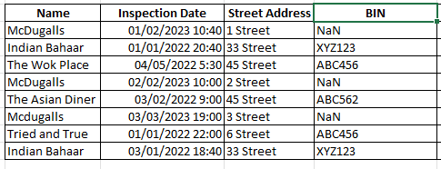
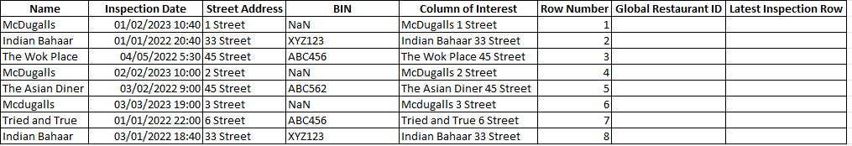

Prepwork before Fuzzy Functions:
Add a new column called Row Number to every cleaned Table. This just acts as an Index and labels the rows from 1 to the last row number.
Add a new empty column called ‘Global Restaurant ID’. This is the Restaurant ID we are creating and this will use a global variable that is incremented whenever a new unencountered restaurant is encountered.
Ann a new empty column called ‘Latest Inspection Row’. This column is empty everywhere but the row with the latest timestamp, for each individual Global Restaurant ID. For restaurants that only have 1 entry in the table, they have a 1 in their singular row. This will be done by a function after all Global Restaurant IDs are entered.
Combine Restaurant Name and Street Address into a new column called ‘Column of Interest’

Slide 11

Function A: Comparing a CSV by Itself
Step 1 -> Keep only those rows that have nothing in the Global Restaurant ID as a separate filtered Dataframe. This improves performance and prevents overwriting. Does not matter when we pass our first Table into it. There are no changes in the figure below:
Step 2 -> Group Rows by BIN. The function groups rows by BIN, then for each BIN, compares a row with others and checks if the ‘Column of Interest’ entries match with a score above the threshold. If they do, it assigns each row the same Global Restaurant ID. If a Row doesn’t match any other rows, it is given the next available Global Restaurant ID
Step 3 -> Once all rows are filled, combine this filtered dataframe to the original dataframe, using the row number column as the index to join on.

Slide 12
Function B: Comparting two CSVs
This works similar to the previous function, with some changes.
We pass in 2 dataframes – Dataframe A, which has all rows filled with Global Restaurant IDs, and Dataframe B, which have none or partially filled rows with Global Restaurant IDs.
The function only keeps a single row from Dataframe A as a filtered Dataframe. This is to improve performance and reduce comparisons. The function only keeps empty rows from Dataframe B for the same reasons.
Rows from both Dataframes are grouped by BIN. Then, rows from Dataframe A are compared to Dataframe B, and wherever the rows (Column of Interest) match, the Global Restaurant ID from Dataframe A is copied into matching rows of Dataframe B.
Now, the resulting partial dataframe is joined to Dataframe B using the Row Number column as Index to join on.

Slide 13
All Steps in Sequence:
Consider 3 Dataframes: Inspections, Historic, and Dohmh (A, B, and C)
Step 1: Inspections (Dataframe A) is passed to Function A. Now it has Global restaurant ID in all its rows.
Step 2: Historic (Dataframe B) and Inspections (Dataframe A) are passed to function B. Now Historic (Dataframe B) has partially filled rows with Global Restaurant ID on rows where the Column of Interest matches Dataframe A.
Step 3: Historic (Dataframe B) is passed to Function A. Now the remaining rows are filled with Global Restaurant ID. Now Historic has a Global Restaurant ID in all its rows.
Step 4: Dohmh (Dataframe C) and Inspections (Dataframe A) are passed to function B. Now it has partially filled rows that match entries in A.
Step 5: Dohmh (Dataframe C) and Historic (Dataframe B) are passed to function B. Now it has even more partially filled rows, now having filled rows that match entries in B.
Step 6: For the remaining rows, Dohmh (Dataframe C) Is passed to function A. Now, all remaining rows are filled with Global Restaurant ID

Slide 14
Issues to fix:
The function to present the latest inspection row in the DOHMH table doesn’t work.
My OLAP model doesn’t seem to fit satisfactorily with the data.
I might have to create a separate database for the scraped data.
Might need to scrape more restaurants from TripAdvisor in order to better fit the database.
Decided not to scrape and set up PostGres

